Slide 1



AGGRESSIVE DETECTION OF COTTON BOLLS
USING DEEP LEARNING
PRESENTED BY: GUIDED BY:
Nagul K S - 20CSR131 Mr.T.Kumaravel
Naveen A M- 20CSR136
Sakthi Sundaram A - 20CSR178
Department of Computer Science and Engineering

Slide 2
INTRODUCTION
Cotton, one of the world's most important crops, plays a pivotal role in the textile industry.
Robotics and automation are transforming agriculture, and cotton harvesting is no exception.
The primary aim is to design robots that can efficiently and delicately pick cotton bolls from the plants.
Notes:
Semantic segmentation is different from classification. Classification assigns a single class to the whole image, whereas semantic segmentation classifies every pixel of the image to one of the classes.

Slide 3
PROBLEM STATEMENT
The manual harvesting of cotton has limitations in terms of speed.
Efficient and accurate robotic harvesting of cotton bolls in agricultural fields is a pressing challenge.
The challenge is to create lightweight convolutional neural network (CNN) models that can perform segmentation of in-field cotton bolls with minimal errors, enabling cotton harvesting robots to identify and harvest cotton efficiently. Existing mechanical harvesting methods may lack precision.

Slide 4
LITERATURE REVIEW
NAME | ACCURACY | YEAR | PAPER
Atila, Ü., Uçar, M., Akyol, K., Uçar, E | 85.48 | 2021 | Plant leaf disease classification using Efficient Net deep learning model
Adhikari, S.P., Yang, H., Kim, H. | 82.5 | 2019 | Learning semantic graphics using convolutional encoder–decoder network for autonomous weeding in paddy.
Badrinarayanan, V., Kendall, A., Cipolla, R. | 77.9 | 2018 | SegNet: a deep convolutional encoder decoder architecture for image segmentation
Bengio, Y., Simard, P., Frasconi, P | 75.5 | 2017 | Learning long-term dependencies with gradient descent is difficult

Slide 5
EXISTING SYSTEM
The developed models were compared with existing state-of-the-art networks namely VGG.
Singh et al used existing state-of-the-art deep learning models to discriminate the cotton pixels from the sky, and achieved an IoU score of above 80.0%.
A comprehensive evaluation, the performance of developed models was also compared with the cotton segmentation results obtained using existing state-of the-art networks.
The Efficient Net models are smaller and faster as compared to other existing state-of-the-art models.
Notes:
VGG:Visual Geometry Group(it is a standard deep Convolutional Neural Network (CNN) architecture with multiple layers. The “deep” refers to the number of layers with VGG-16 or VGG-19 consisting of 16 and 19 convolutional layers.)
IoU:Intersection over Union(A high IoU score indicates a good detection performance, while a low score indicates poor detection performance.)

Slide 6
DISADVANTAGES EXISTING SYSTEM
The inclusion of additional layers in architecture may lead to an increase in training error due to degradation and vanishing gradient problems.
The depth of VGG models results in a large number of parameters.
Due to the large number of parameters, VGG models consume a considerable amount of GPU memory during training, limiting the batch size that can fit into GPU memory.
VGG was primarily designed for image classification tasks.
VGG models, especially when applied to small datasets, are prone to overfitting due to their large capacity.

Slide 7
PROPOSED SYSTEM
UNet is efficient, with skip connections that preserve spatial information, making it suitable for cotton boll segmentation in agriculture.
It comprises an encoder-decoder structure, where the encoder captures features through convolutional layers, and the decoder produces a segmentation map.
Proposed models segment the cotton bolls successfully with the cotton-IoU (intersection-over-union) value of above 93.0%. The highest cotton-IoU of 99.00% was achieved by increasing epoch.

Slide 8
ALGORITHM
Classification model and machine learning techniques
CNN (Unet Architecture)
Image Dimensions = n1 x n2 x 1 where n1 = height, n2 = breadth, and 1 = Number of channels such as RGB.
Input image size: 5x5 pixels
Convolutional filter size: 3x3 pixels
Stride: 1 (how much the filter shifts after each operation)
No padding (padding adds additional border pixels to the input)

Slide 9
MODULES OF THE PROJECT
Normalization(Preprocessing)
Calculating Class Weight
Train Test Split
CNN-Conv. Neural Networks
F1 Function-Calculating Accuracy
Loss Function-Calculating Errors
Accuracy

Slide 10
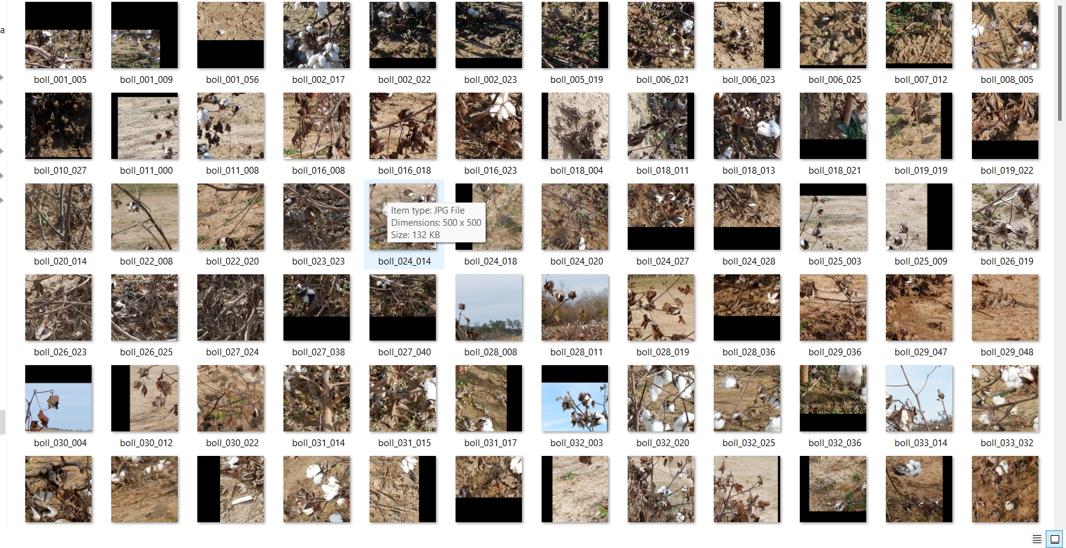
DATASET

Slide 11
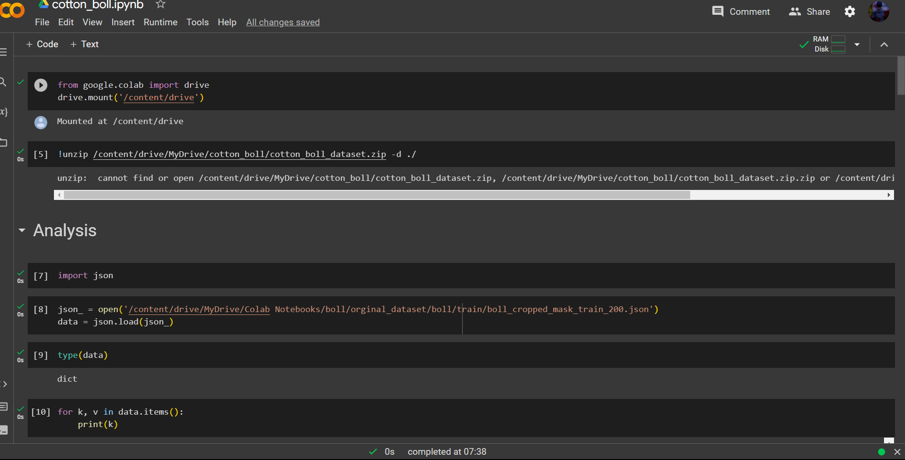
IMPLEMENTATION

Slide 12
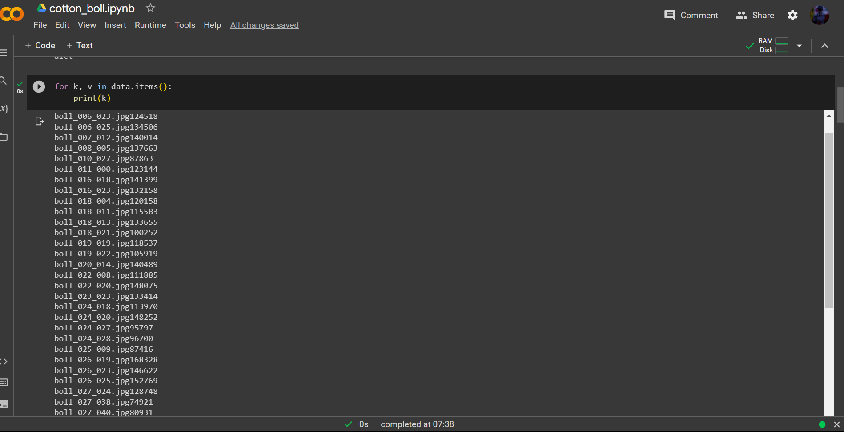
IMPLEMENTATION

Slide 13
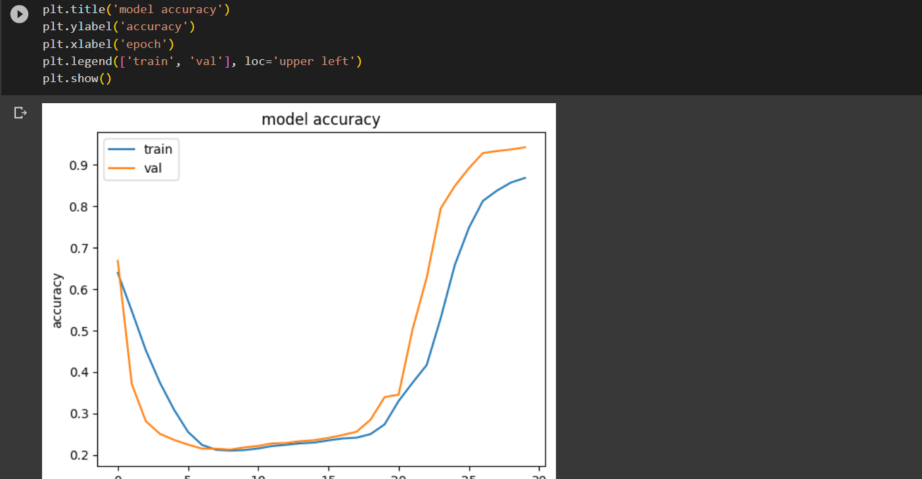
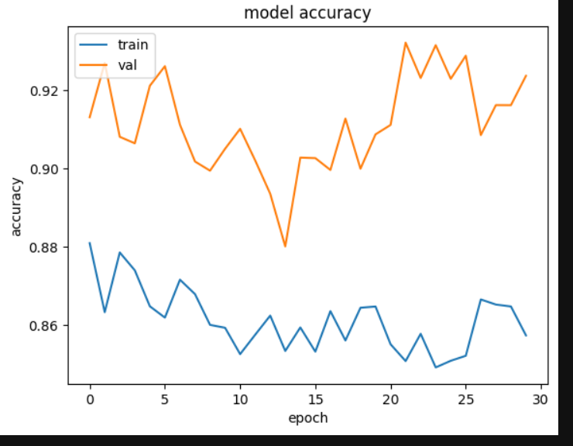

Slide 14
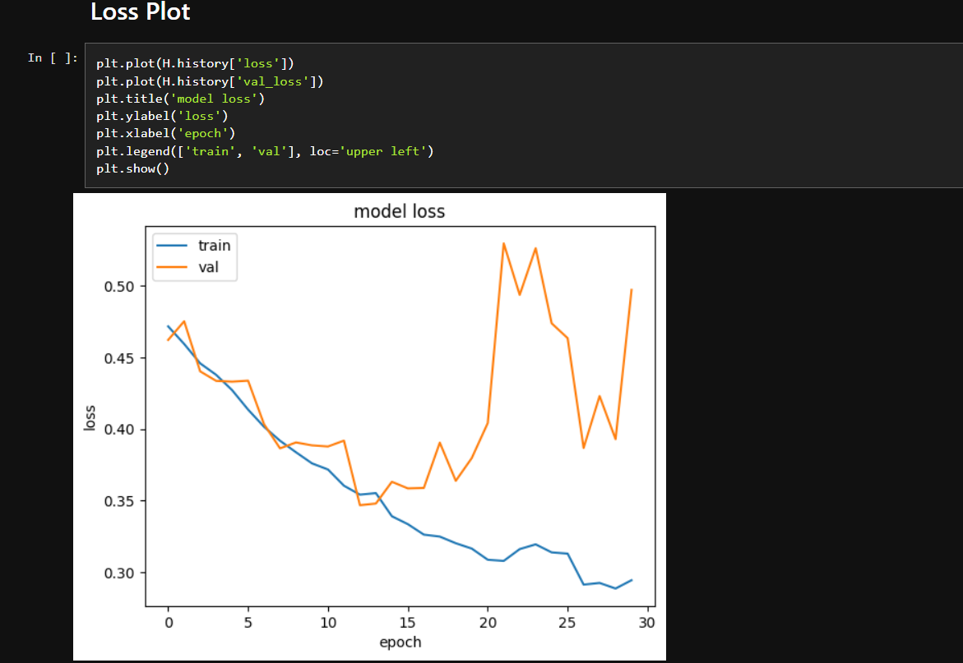

Slide 15
Performance of UNet
Epoch | Precision | Recall | Validation Accuracy | Validation Loss
1 | 0.1121 | 0.1120 | 0.3149 | 0.6961
5 | 0.1109 | 0.1120 | 0.2439 | 0.6886
10 | 0.1103 | 0.1120 | 0.2277 | 0.0.6718
15 | 0.1093 | 0.1120 | 0.2375 | 0.6728
Epoch | Precision | Recall | Validation Accuracy | Validation Loss
1 | 0.1124 | 0.1120 | 0.9131 | 0.4621
20 | 0.1091 | 0.1120 | 0.9659 | 0.3181
77 | 0.1138 | 0.1120 | 0.9707 | 0.3080
500 | 0.1132 | 0.1120 | 0.9831 | 0.1054
1000 | 0.1095 | 0.1120 | 0.9907 | 0.0487
TABLE I. PERFORMANCE OF UNet on Training-I
TABLE II. PERFORMANCE OF UNet on Training-II

Slide 16
Comparison of UNet & VGG16
Epoch | Validation Accuracy(VGG16) | Validation Accuracy(Unet)
1 | 0.9089 | 0.9123
20 | 0.9634 | 0.9659
500 | 0.9786 | 0.9831
1000 | 0.9843 | 0.9907

Slide 17
Conclusion
Cotton harvesting robots show promise in improving efficiency and reducing losses.
The use of Convolutional Neural Networks (CNN) like U-Net helps accurately recognize and segment cotton bolls, minimizing false positives.
Demonstrates CNN U-Net's effectiveness in cotton harvesting, achieving 99% accuracy.
Potential for seamless integration into cotton harvesting robots for increased efficiency and reduced errors in agriculture.

Slide 18
REFERENCE
[1] Adhikari, S.P., Yang, H., Kim, H., 2019. Learning semantic graphics using convolutional encoder–decoder network for autonomous weeding in paddy. Front. Plant Sci. 10, 1404. https://doi.org/10.3389/fpls.2019.01404.
[2] Atila, Ü., Uçar, M., Akyol, K., Uçar, E., 2021. Plant leaf disease classification using EfficientNet deep learning model. Ecol. Inform. 61, 101182. https://doi.org/10.1016/ j.ecoinf.2020.101182.

Slide 19
REFERENCE
[3] Badrinarayanan, V., Kendall, A., Cipolla, R., 2017. SegNet: a deep convolutional encoderdecoder architecture for image segmentation. IEEE Trans. Pattern Anal. Mach. Intell. 39, 2481–2495. https://doi.org/10.1109/TPAMI.2016.2644615.
[4] Bengio, Y., Simard, P., Frasconi, P., 1994. Learning long-term dependencies with gradient descent is difficult. IEEE Trans. Neural Netw. 5, 157–166. https://doi.org/10.1109/72. 279181.

Slide 20
REFERENCE
[5] Braunack, M.V., Johnston, D.B., 2014. Changes in soil cone resistance due to cotton picker traffic during harvest on Australian cotton soils. Soil Tillage Res. 140, 29–39. https:// doi.org/10.1016/j.still.2014.02.007.
[6] Chen, Z., Ting, D., Newbury, R., Chen, C., 2021. Semantic segmentation for partially occluded apple trees based on deep learning. Comput. Electron. Agric. 181, 105952. https://doi.org/10.1016/j.compag.2020.105952.

Slide 21
REFERENCE
[7]. Duong, L.T., Nguyen, P.T., Di Sipio, C., Di Ruscio, D., 2020. Automated fruit recognition using EfficientNet and MixNet. Comput. Electron. Agric. 171, 105326. https://doi. org/10.1016/j.compag.2020.105326.
[8]. Dyrmann, M., Karstoft, H., Midtiby, H.S., 2016. Plant species classification using deep convolutional neural network. Biosyst. Eng. 151, 72–80. https://doi.org/10.1016/j. biosystemseng.2016.08.024.
[9]. Gonzalez-Huitron, V., León-Borges, J.A., Rodriguez-Mata, A.E., Amabilis-Sosa, L.E., Ramírez-Pereda, B., Rodriguez, H., 2021. Disease detection in tomato leaves via CNN with lightweight architectures implemented in Raspberry Pi 4. Comput. Electron. Agric. 181, 105951. https://doi.org/10.1016/j.compag.2020.105951.

Slide 22
REFERENCE
[10] Wilson, D.R., Martinez, T.R., 2003. The general inefficiency of batch training for gradient descent learning. Neural Netw. 16, 1429–1451. https://doi.org/10.1016/S0893-6080 (03)00138-2.
[11] Xu, L., Li, Y., Xu, J., Guo, L., 2020. Two-level attention and score consistency network for plant segmentation. Comput. Electron. Agric. 170, 105281. https://doi.org/10.1016/j. compag.2020.105281.
[12] Zou, K., Chen, X., Wang, Y., Zhang, C., Zhang, F., 2021. A modified U-net with a specific data argumentation method for semantic segmentation of weed images in the field. Comput. Electron. Agric. 187, 106242. https://doi.org/10.1016/j.compag.2021. 106242.

Slide 23
THANK YOU!.......

